Slide 1



AD_HOC INSIGHTS
Consumer Goods

Slide 2



company overview
•01. Global Presence & Market Position
•Atliq Hardware is a top-tier computer hardware manufacturer headquartered in India.
•The company operates successfully in 26 countries, establishing a strong international footprint.
•Known for its high-quality and reliable technology solutions, Atliq has earned a solid reputation in global markets.
•02. Business Focus
•The company operates across three core divisions:
•Peripherals & Accessories
•Networking & Storage
•Personal Computers (PCs)
•Atliq is a trusted partner for 76 major clients, including industry giants like Amazon, Neptune, Croma, and DigiMarket, praised for its consistent performance and commitment to innovation.

Slide 3
Problem Statement
Business Challenge
•Executives are facing delays in decision-making due to a lack of timely, actionable insights.
•Although the company collects large amounts of data, it's not being effectively analyzed for fast strategic planning.
Team Expansion Initiative
•To address this, Atliq Hardware plans to recruit junior data analysts to boost its analytical capabilities.
•The focus is on individuals with strong SQL expertise and effective communication skills, ensuring both technical proficiency and clarity in presenting insights.
Project Objective
•Candidates will work on solving 10 real-world ad hoc business problems using SQL.
•The goal is to translate complex data into clear, impactful insights that drive informed business decisions.

Slide 4
Objectives
•Atliq Hardware is a major computer hardware company based in India with a significant international presence
•The company’s leadership has identified a gap in data-driven insights, which hinders timely and well-informed decision-making.
•To address this, Atliq plans to expand the data analytics team by hiring junior data analysts.
•The hiring process will be led by Tony Sharma, the Director of Data Analytics.
•Candidates will undergo an SQL challenge designed to assess:
•Technical skills (SQL proficiency and data handling)
•Soft skills (communication, analytical thinking, etc.)
•The company seeks data-driven answers for 10 ad hoc business questions as part of this evaluation.

Slide 5
Request:1
Provide the list of markets in which customer "Atliq Exclusive" operates its business in the APAC region
Query :
select market from dim_customerwhere
customer like "%Atliq Exclusive%" and region="APAC“
group by market
order by market;

Slide 6
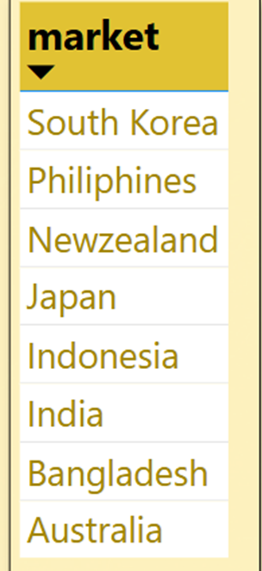
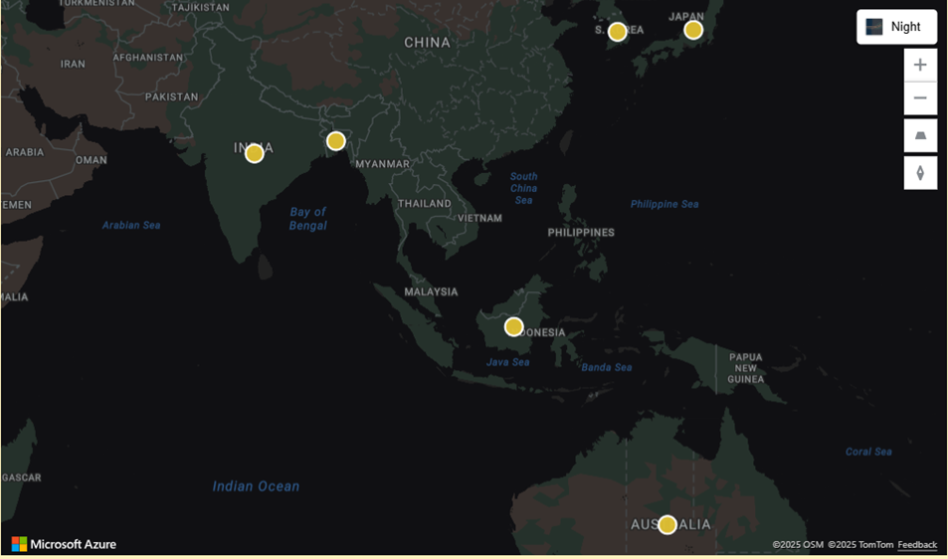

Insights:
Atliq Exclusive has established operations in 8 diverse markets within the APAC region, showcasing a robust and widespread regional footprint.
This wide presence enables the company to effectively tailor its strategies to specific markets, enhancing customer engagement and driving regional growth.

Slide 7
Request: 2
What is the percentage of unique product increase in 2021 vs. 2020?
Query :
SELECT
X.A AS unique_product_2020, Y.B AS unique_products_2021,
concat(ROUND((B-A)*100/A, 2), '%') AS percentage_chg
FROM
((select count(distinct(product_code)) as A from fact_sales_monthly
where fiscal_year=2020) x,
(select count(distinct(product_code)) as B from fact_sales_monthly
where fiscal_year=2021) y);

Slide 8
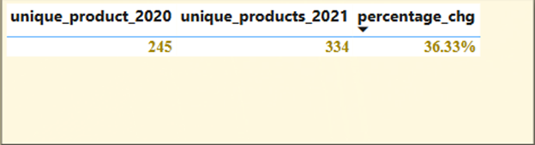

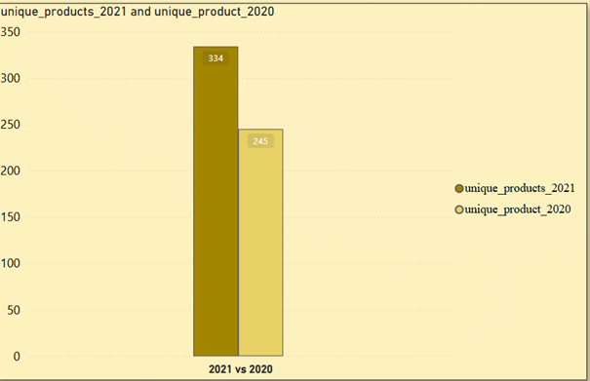
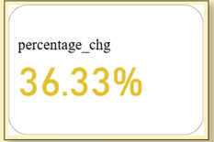
Insights:
Atliq Hardware experienced a notable 36.33% growth in its unique product offerings, expanding from 245 in 2020 to 334 in 2021.

Slide 9
Request: 3
Provide a report with all the unique product counts for each segment and sort them in descending order of product counts
Query :
select
segment, count(distinct(product_code)) as product_count
from dim_product
group by segment
order by product_count desc;

Slide 10
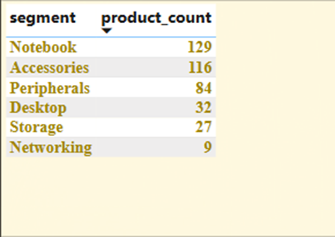
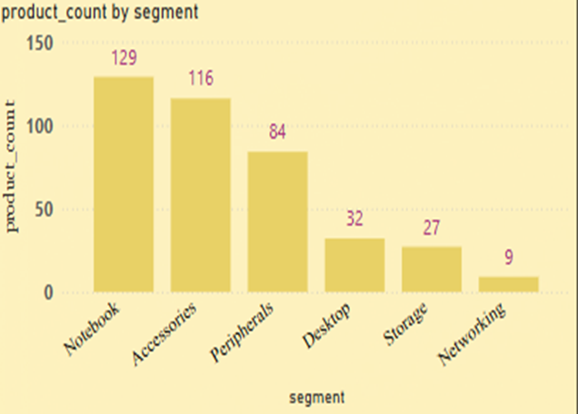

Insights:
The highest number of unique products are found in the Notebook and Accessories segments, suggesting these are key focus areas for the company.
• In contrast, the Networking and Storage categories show limited variety, pointing to opportunities for future growth.

Slide 11
Request: 4
Follow-up: Which segment had the most increase in unique products in 2021 vs 2020?
Query :
SELECT
A.segment, A.x AS product_count_2020, B.y AS product_count_2021, (B.y - A.x) AS difference
FROM
(SELECT p.segment, COUNT(DISTINCT p.product_code) AS x FROM dim_product p
JOIN fact_sales_monthly s ON p.product_code = s.product_code
WHERE fiscal_year = 2020 GROUP BY p.segment) A
JOIN (SELECT p.segment, COUNT(DISTINCT p.product_code) AS y FROM dim_product p
JOIN fact_sales_monthly s ON p.product_code = s.product_code
WHERE fiscal_year = 2021
GROUP BY p.segment) B ON A.segment = B.segment;

Slide 12
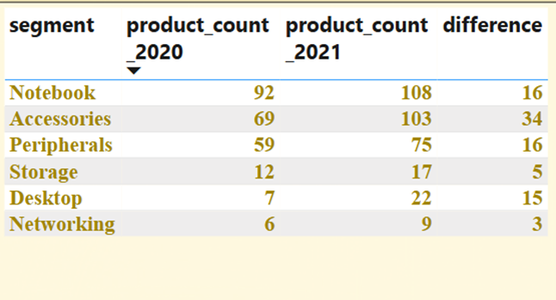
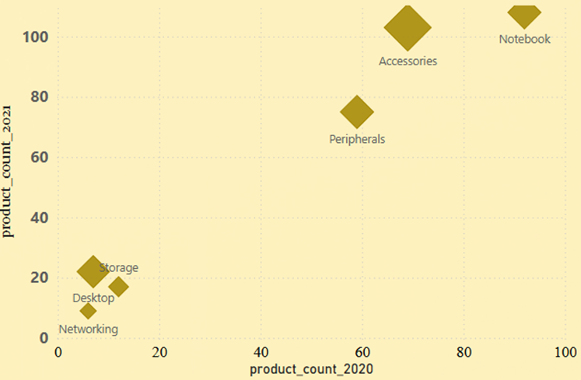

Insights:
• The Accessories segment experienced the most significant growth in unique products, expanding by 34 items between 2020 and 2021.
• This surge underscores the category’s strong momentum and potential for continued innovation and development.

Slide 13
Request: 5
Get the products that have the highest and lowest manufacturing costs.
Query :
Select
p.product_code,p.product,manufacturing_cost
from dim_product p
join fact_manufacturing_cost m on p.product_code=m.product_code
where manufacturing_cost in ( select max(manufacturing_cost)
from fact_manufacturing_cost union select min(manufacturing_cost)
from fact_manufacturing_cost)
order by manufacturing_cost desc;

Slide 14
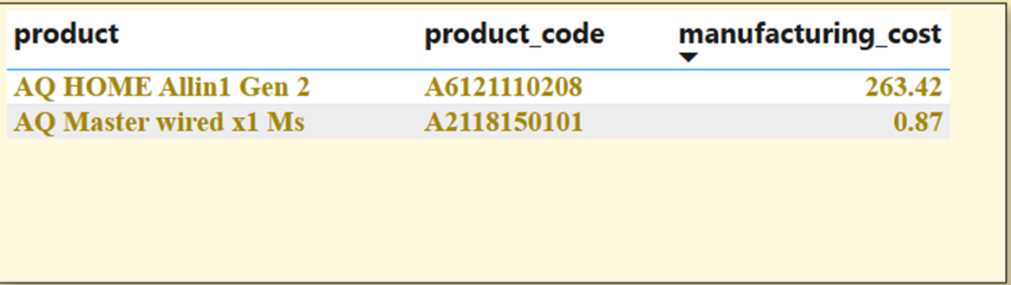
Insights:
• Pinpoints products with the highest and lowest manufacturing costs, revealing disparities in production spending.
• Supports strategic pricing decisions and enhances overall cost optimization efforts

Slide 15
Request: 6
Generate a report which contains the top 5 customers who received an average high pre_invoice_discount_pct for the fiscal year 2021 and in the Indian market.
Query :
Select
c.customer_code,c.customer, round(avg(pre_invoice_discount_pct),4) as average_discount_percentage
from dim_customer c
join fact_pre_invoice_deductions pre on pre.customer_code=c.customer_code
where fiscal_year=2021 and market="india"
group by customer
order by average_discount_percentage desc limit 5;

Slide 16
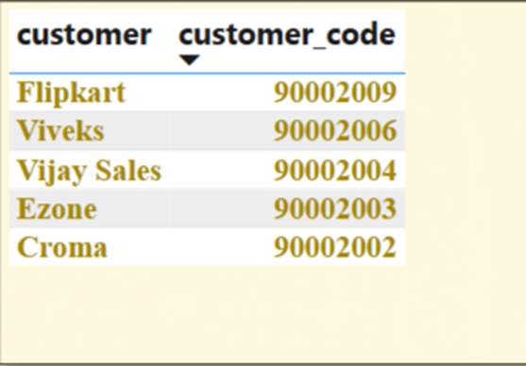
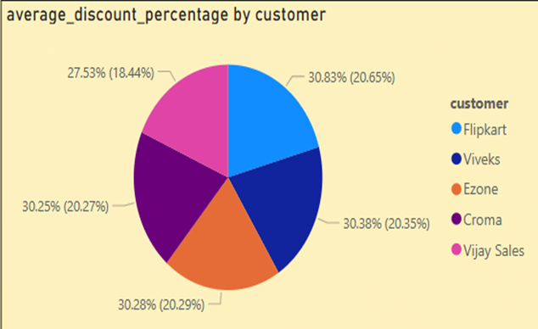
Insights:
• In FY 2021, Flipkart secured the highest average pre-invoice discount at 30.83% among leading Indian customers, reflecting its strong bargaining power or substantial order volumes.
• All top five customers received discounts close to or exceeding 30%, underscoring a highly competitive and aggressively discounted market landscape.

Slide 17
Request: 7
Get the complete report of the Gross sales amount for the customer “Atliq Exclusive” for each month This analysis helps to get an idea of low and high-performing months and take strategic decisions.
Query :
Select
monthname(date) as month ,s.fiscal_year as FY_year ,round(sum(sold_quantity*gross_price),2) as Gross_sales_Amount
from fact_sales_monthly s
join fact_gross_price gp on s.product_code=gp.product_code
join dim_customer c on c.customer_code=s.customer_code
where customer="Atliq Exclusive"
group by month,FY_year
order by FY_year;

Slide 18
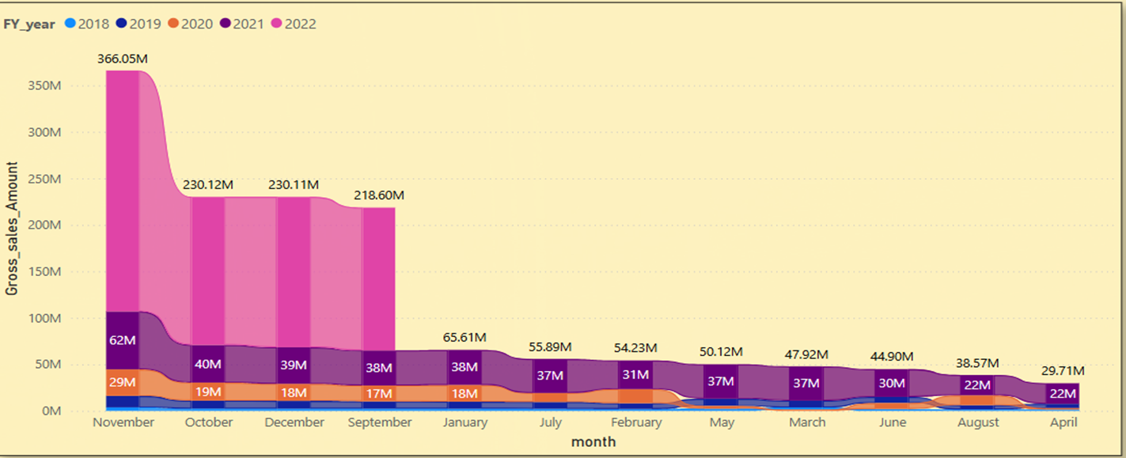
Insights:
•"Atliq Exclusive" experienced a significant surge in gross sales throughout 2021, with November marking the highest point—reaching ₹2.04 crore in Hyderabad, Telangana.
•Monthly sales in 2021 consistently surpassed those of 2020, reflecting robust year-over-year growth and a clear upward momentum in performance.

Slide 19
Request: 8
In which quarter of 2020, got the maximum total_sold_quantity? The final output contains these fields sorted by thetotal_sold_quantity, Quarter total_sold_quantity
Query :
SELECT
CASEWHEN MONTH(date) BETWEEN 9 AND 11 THEN 'Q1’
WHEN MONTH(date) BETWEEN 12 AND 2 THEN 'Q2’
WHEN MONTH(date) BETWEEN 3 AND 5 THEN 'Q3'
WHEN MONTH(date) BETWEEN 6 AND 8 THEN 'Q4’
END AS Quarter, sum(sold_quantity) as total_sold_quantity
FROM fact_sales_monthly
where fiscal_year=2020
group by Quarter;

Slide 20
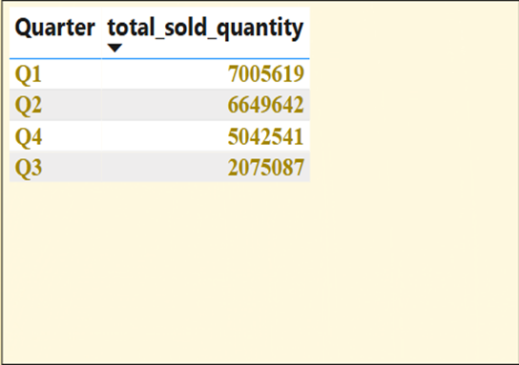

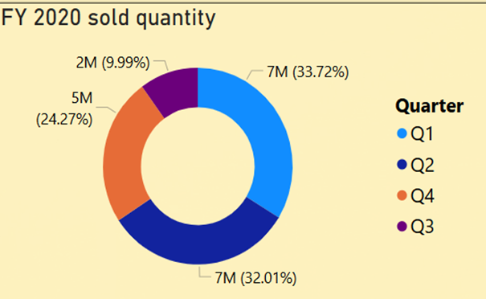
Insights:
Quarter 1 led the year with the strongest performance, recording 7 million units sold and contributing
33.72% to the annual sales total.
In contrast, Quarter 3 lagged behind, accounting for only 9.97% of overall sales—making it the weakest
quarter of the year.

Slide 21
Request: 9
Which channel helped to bring more gross sales in the fiscal year 2021 and the percentage of contribution?
Query :
with cte1 as
(select c.channel , ROUND(SUM(gp.gross_price*s.sold_quantity/1000000), 2) as gross_sales_mln from
fact_sales_monthly s join fact_gross_price gp on s.product_code=gp.product_code
join dim_customer c on c.customer_code=s.customer_code
where s.fiscal_year=2021 group by channel )
select channel, gross_sales_mln, concat(round((gross_sales_mln*100/total),2),'%') as percentage
from
((select round(sum(gross_sales_mln),2) as total from cte1) A, (select*from cte1) B)
order by percentage desc;

Slide 22
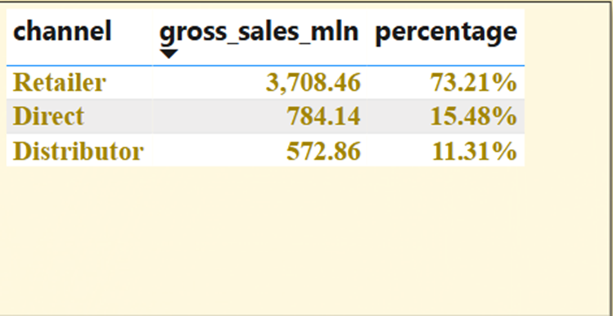
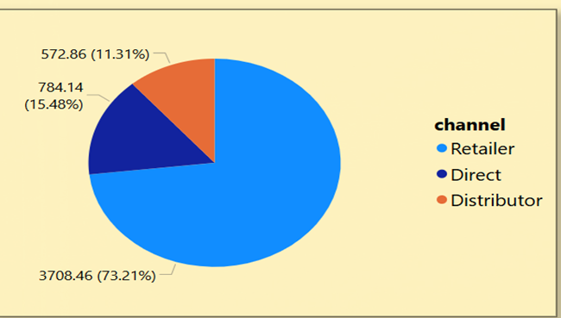

Insights:
• The Accessories segment experienced the most significant growth in unique products, expanding by 34 items between 2020 and 2021.
• This surge underscores the category’s strong momentum and potential for continued innovation and development.

Slide 23
Request: 10
Get the Top 3 products in each division that have a high total_sold_quantity in the fiscal_year 2021?
Query :
with cte2 as
(with cte1 as (select s.product_code, p.product,p.division, sum(s.sold_quantity) as total_sold_qty fromfact_sales_monthly s
join dim_product p on s.product_code=p.product_code
where fiscal_year=2021
group byp.product,s.product_code,p.division )
select*,dense_rank() over( partition by division order by total_sold_qty desc) as drank from cte1) select*from cte2
where drank<=3;

Slide 24
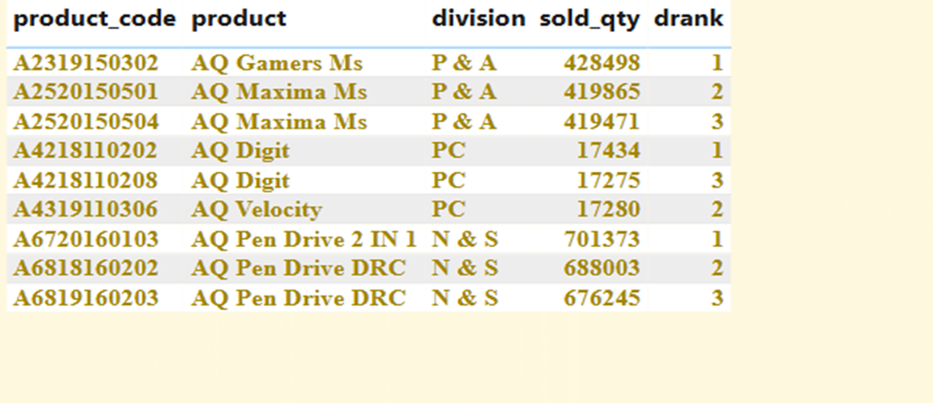
Insights:
•AQ Pen Drive 2 IN I emerged as the top-performing product in the North & South division, with
7 lakh units sold in 2021.
In the P & A and PO divisions, AQ Gamers Ms and AQ Digit were the respective best-sellers, highlighting
strong category-specific demand

Slide 25
Recommendations :
Prioritize High-Growth Segments
Target investment and innovation in segments that saw the largest increase in unique products from
2020 to 2021—these areas reflect rising consumer interest and strong potential for market expansion.
Refine Discount Strategies
The top five customers in India received notably high average pre-invoice discounts in FY 2021.
It’s essential to reassess these structures to ensure they enhance profitability, not just top-line growth.
Maximize Returns from High-Performing Channels
Channels with the highest gross sales in FY 2021 warrant enhanced strategic focus—including investment
marketing efforts, and product availability—to further boost revenue and reinforce market leadership.

